Slide 1


Slide 2
Grouping in TestNG
In TestNG, grouping is a feature that allows you to organize and run specific sets of test methods together by assigning them to one or more groups. This is especially helpful when you have a large number of test cases and want to execute only a subset (e.g., smoke tests, regression tests, sanity tests).
Why Use Grouping in TestNG?
Run only specific types of tests.
Create test suites for different environments or stages (e.g., dev, staging, production).
Avoid redundancy by tagging the same test under multiple categories.

Slide 3
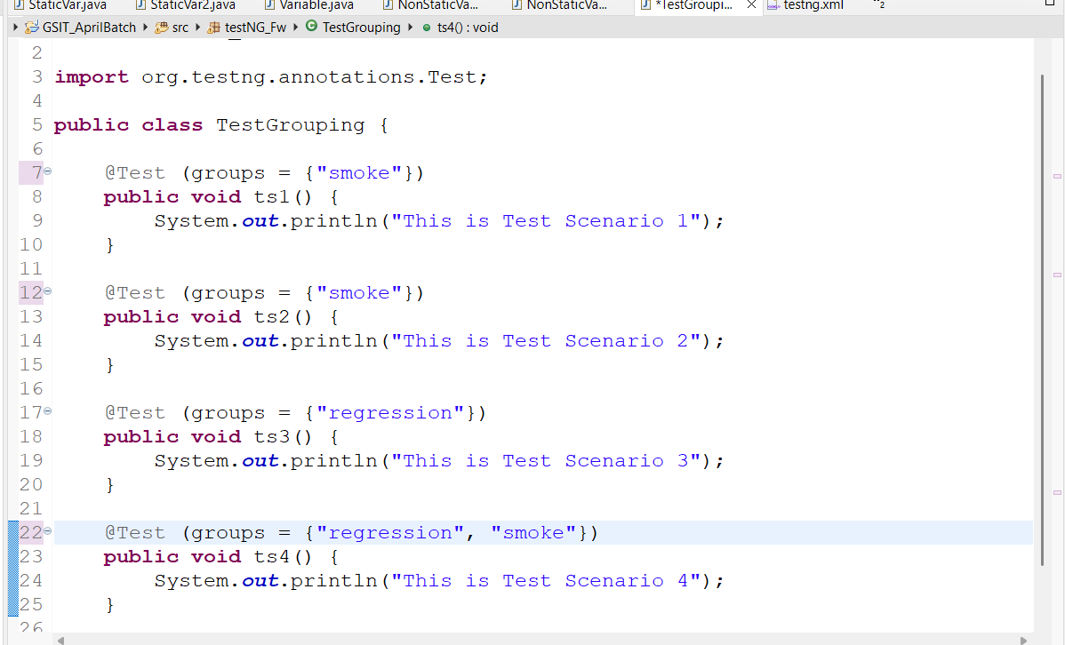
How to use Grouping Concept

Slide 4
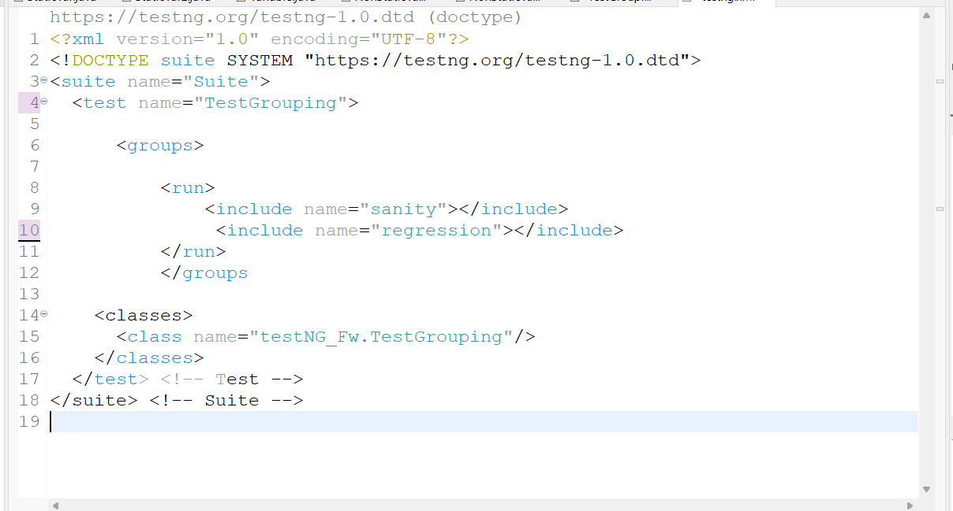
Running Specific Group Using testng.xml

Slide 5
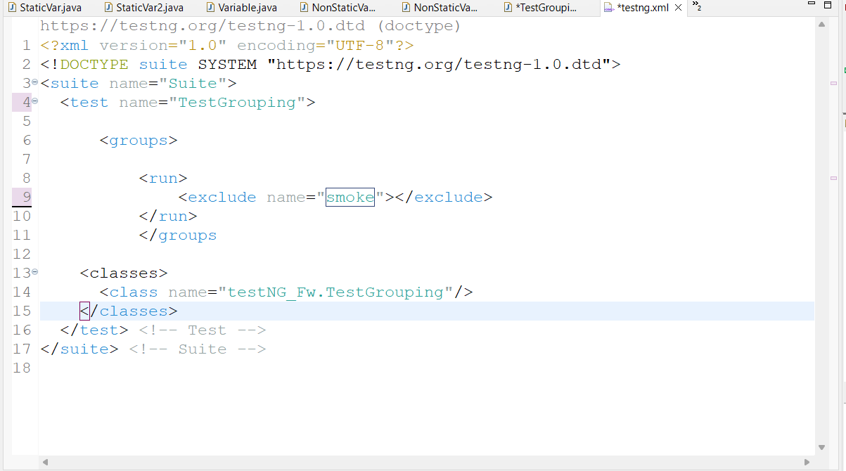
Excluding Specific Group Using testng.xml

Slide 6
@BeforeGroups and @AfterGroups
In TestNG, the annotations @BeforeGroups and @AfterGroups are used to run specific setup or teardown methods before and after a group of tests is executed.
@BeforeGroups → Runs before the first test method in the specified group(s).
@AfterGroups → Runs after all the test methods in the specified group(s) have completed.
Note:
The @BeforeGroups("smoke") method run once before all tests in the smoke group.
The @AfterGroups("smoke") method run once after all tests in that group.
Tests from other groups (like regression) are not affected.

Slide 7
